Slide 1
Prediction of Accidents' Severity Based on Collisions

Slide 2
Data preparation
Columns with nan values are removed
(OBJECTID, INCKEY, COLDETKEY, REPORTNO, EXCEPTRSNCODE, EXCEPTRSNDESC, STATUS, SEVERITYCODE.1, SDOTCOLNUM) removed due to lack of explanation
SDOT_COLDESC, ST_COLDESC, SEVERITYDESC removed because data are redundant.
PERSONCOUNT, PEDCOUNT, PEDCYLCOUNT, VEHCOUNT, HITPARKEDCAR removed because they are results of accidents
PEDROWNOTGRNT, SPEEDING, INATTENTIONIND removed because only ‘yes’ exist in the column.
DOW, HOUR, DAY and MONTH are collected from INCDATE and INCDTTM.
 | SEVERITYCODE | COLLISIONTYPE | JUNCTIONTYPE | SDOT_COLCODE | UNDERINFL | WEATHER | ROADCOND | LIGHTCOND | ST_COLCODE | MONTH | DAY | DOW | HOUR | X_index | Y_index | LOC_index | INTK_index | SEG_index | CROSS_index
0 | 2 | Angles | At Intersection (intersection related) | 11 | 0 | Overcast | Wet | Daylight | 10 | 3 | 27 | 2 | 14 | 1 | 1 | 1 | 1 | 1 | 1
1 | 2 | Angles | At Intersection (intersection related) | 11 | 0 | Raining | Wet | Daylight | 10 | 1 | 28 | 2 | 8 | 1 | 1 | 1 | 1 | 1 | 1
2 | 1 | Angles | At Intersection (intersection related) | 11 | 0 | Clear | Dry | Daylight | 10 | 4 | 20 | 5 | 17 | 1 | 1 | 1 | 1 | 1 | 1
3 | 2 | Cycles | At Intersection (intersection related) | 51 | 0 | Clear | Dry | Daylight | 5 | 4 | 15 | 2 | 17 | 1 | 1 | 1 | 1 | 1 | 1
4 | 2 | Angles | At Intersection (intersection related) | 11 | 0 | Clear | Dry | Daylight | 10 | 3 | 20 | 0 | 15 | 1 | 1 | 1 | 1 | 1 | 1
Table 1 Example of cleaned data set.

Slide 3
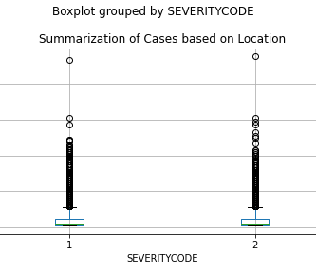
The frequency of accidents at different areas is inhomogeneous. Some areas has higher number of cases than other areas.
Summary of number of cases based on location

Slide 4
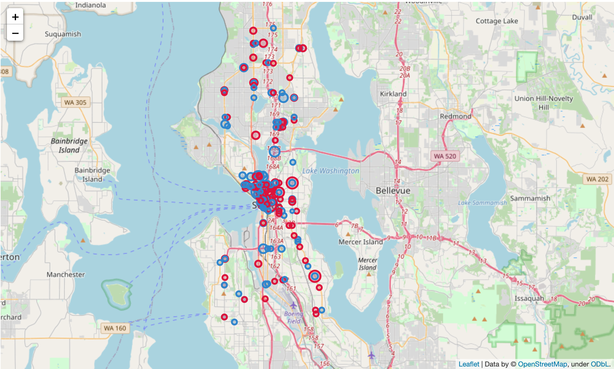
Top 100 location with most cases of severity 1 and severity 2.
Location is downtown with a high risk for car accidents.
blue color -> severity 1
red color -> severity 2
The size of the marker is proportional to the number of cases happened during the research time.
Most cases in downtown
Cases locate on several main roads
Navigate through area without maker or small blue circle

Slide 5
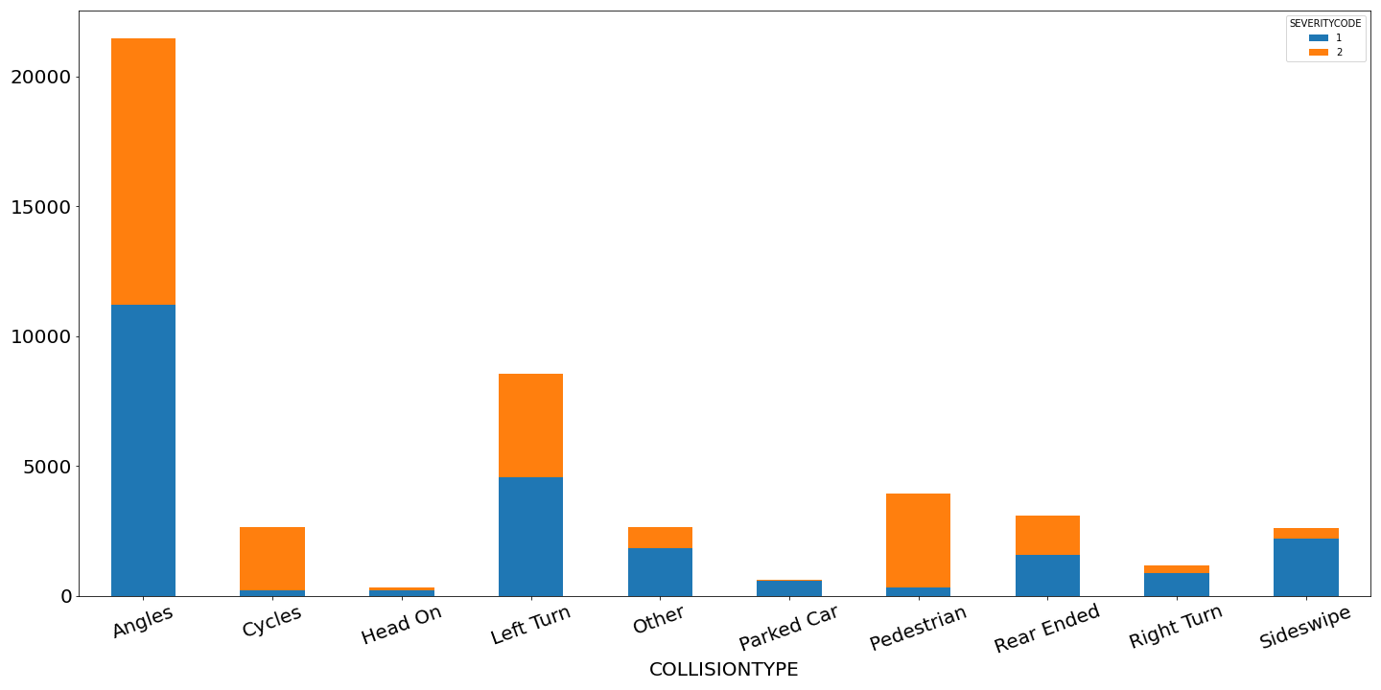
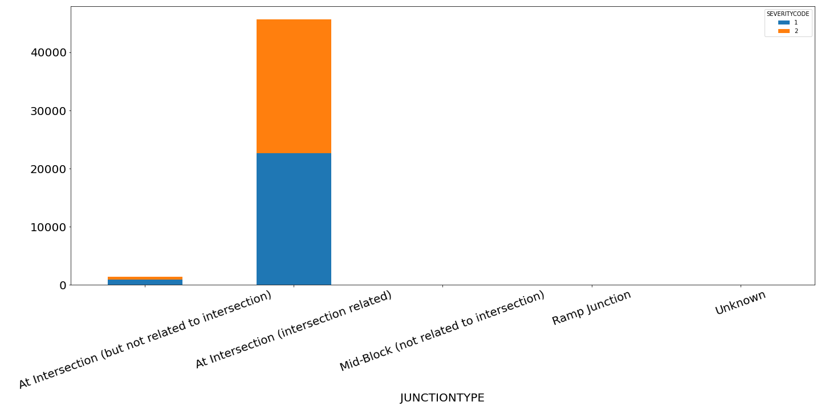
Collision with cycles and pedestrian is likely to cause injury with severity 2.
No significant correlation of other collision type or junction type with severity 1 and 2.
Angle, left turn and accidents at intersection (intersection related) is main reason that cause accidents with severity 1 and 2.
Correlation of collision type (top) and junction type (bottom) with number of cases with different severity.

Slide 6
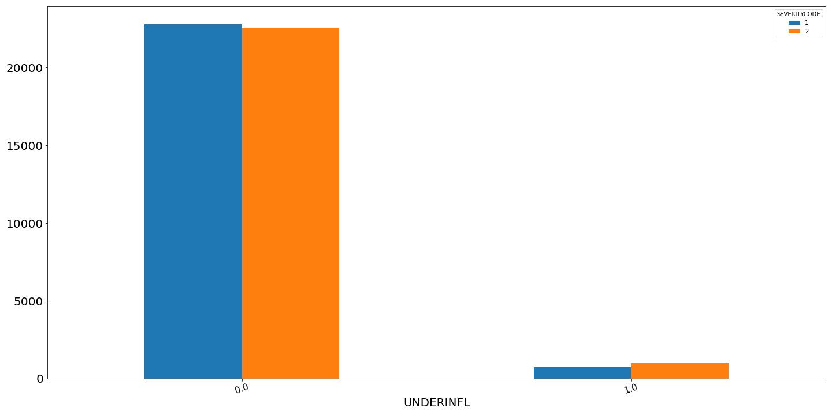
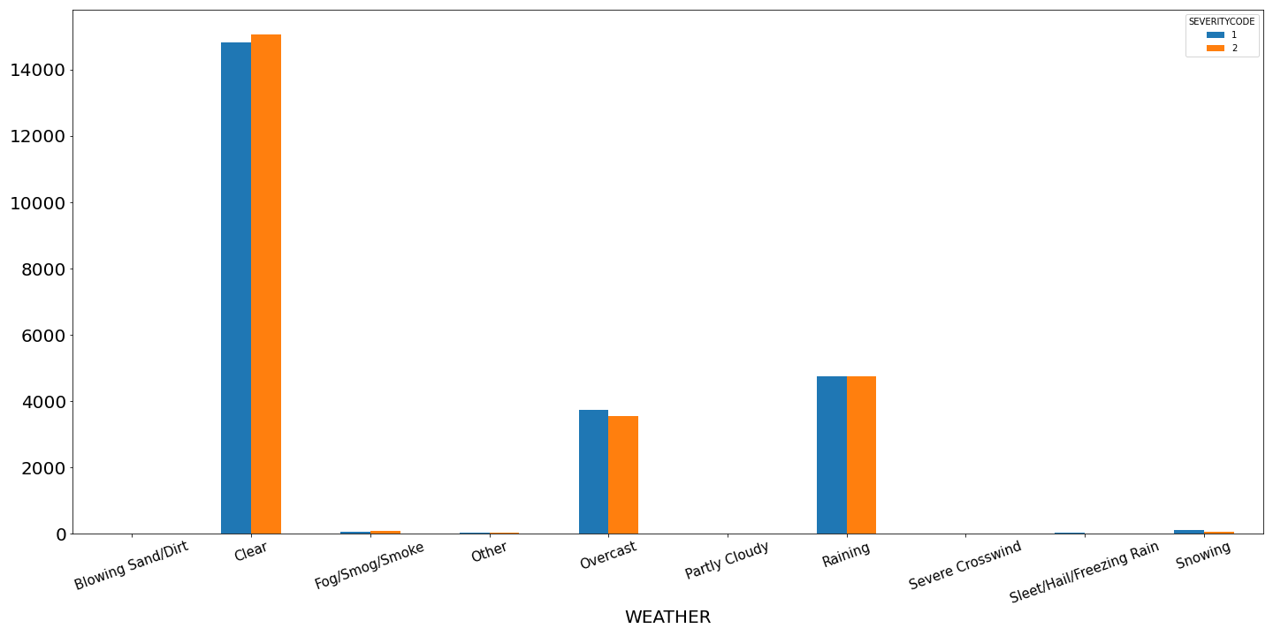
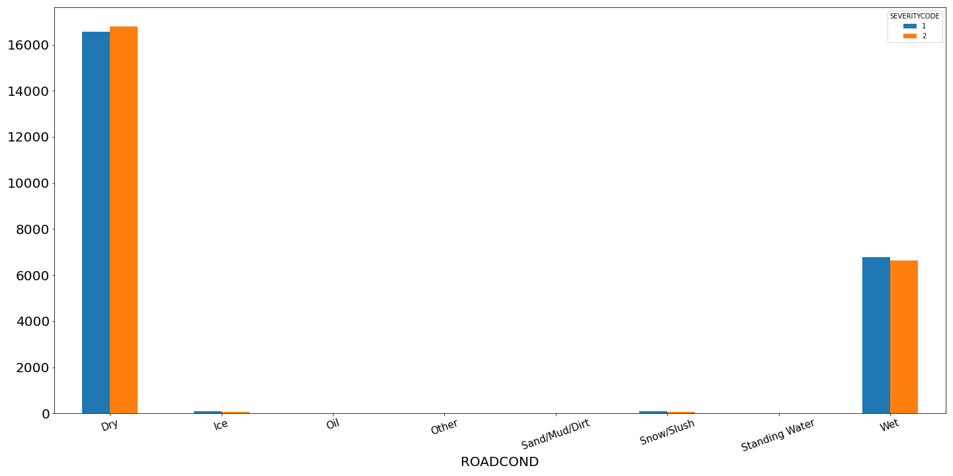
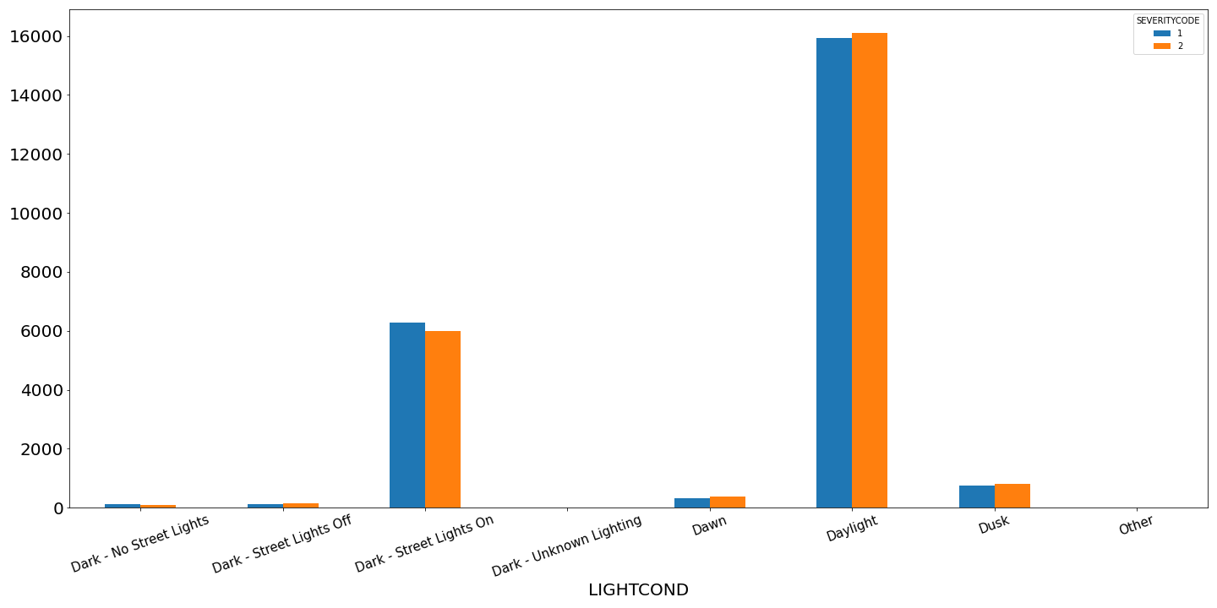
(a)
(b)
Most cases with severity 1 and 2 happened under following conditions:
without drug influence
whether is clear, overcast or raining
Road condition can be wet and dry
Light condition is daylight or streetlights on
No significant correlation between road condition, weather, and light condition with severity of an accident.
Drug and alcohol are likely to cause accidents with severity 2
(c)
(d)
Correlation of influence of alcohol and drug (a), weather (b), road condition (c), light condition (d) with number of cases with different severity.

Slide 7
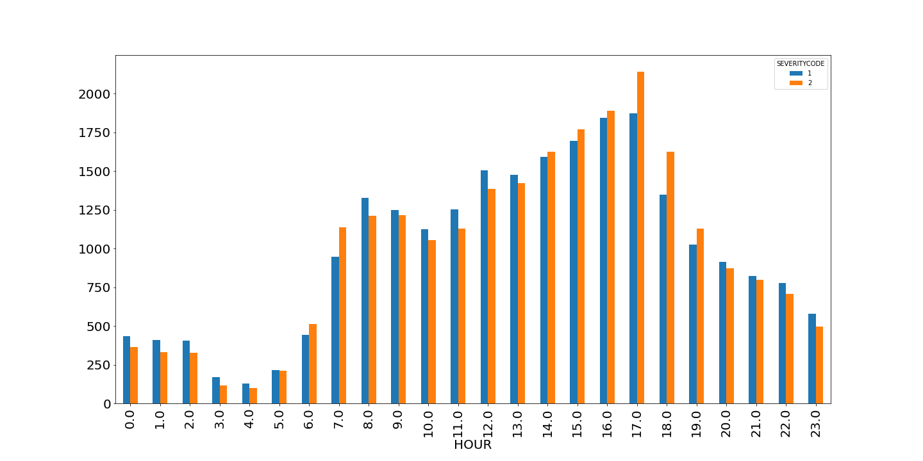
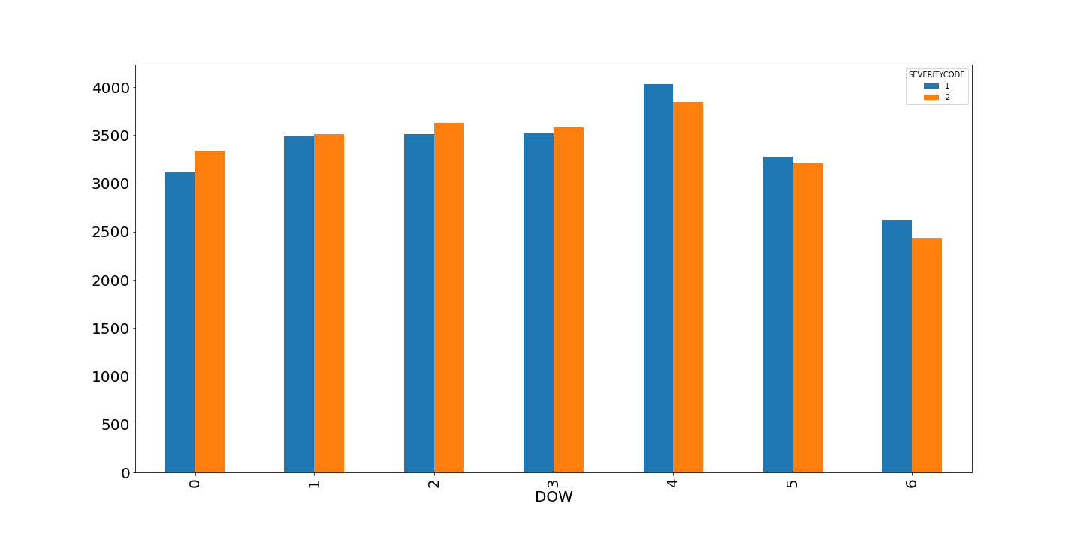
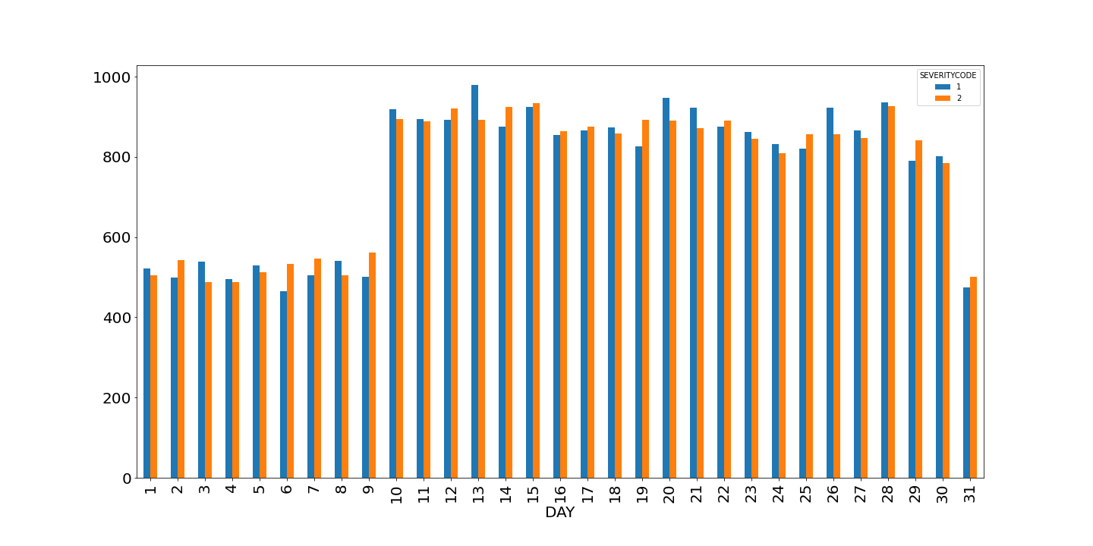
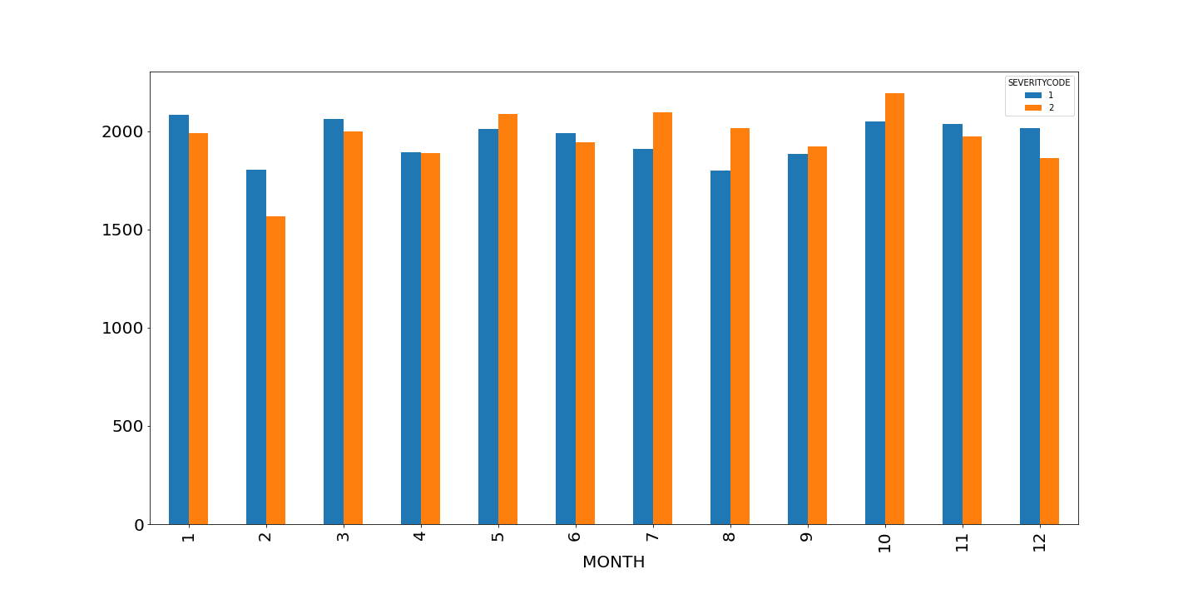
(a)
(b)
Most cases with severity 1 and 2 happened:
at 8 AM and 5 PM
after first week of each month
Fewer cases with severity 1 and 2 happened:
on weekends
in February
No significant correlation between time and severity of an accident.
More injury prone to happen in the afternoon and from July to October.
(c)
(d)
Correlation of hour of a day (a), day of a week (b), day of a month (c), month of a year (d) with number of cases with different severity.

Slide 8
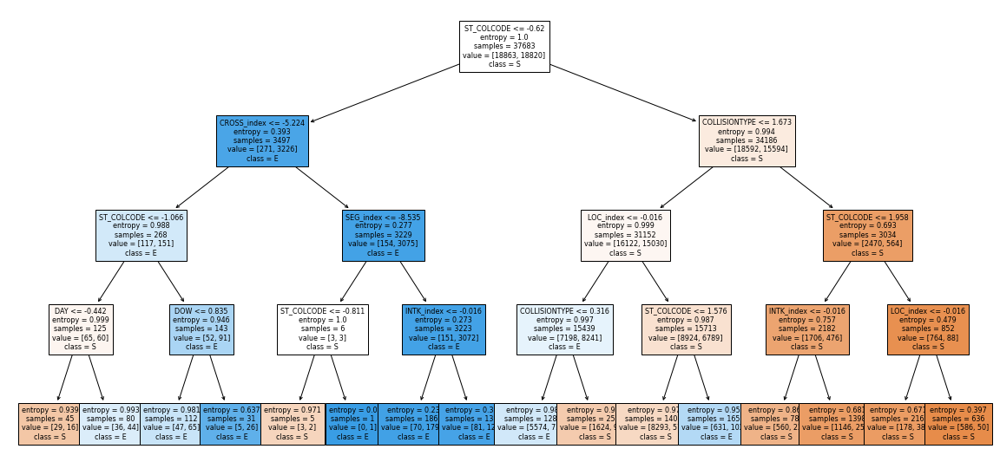
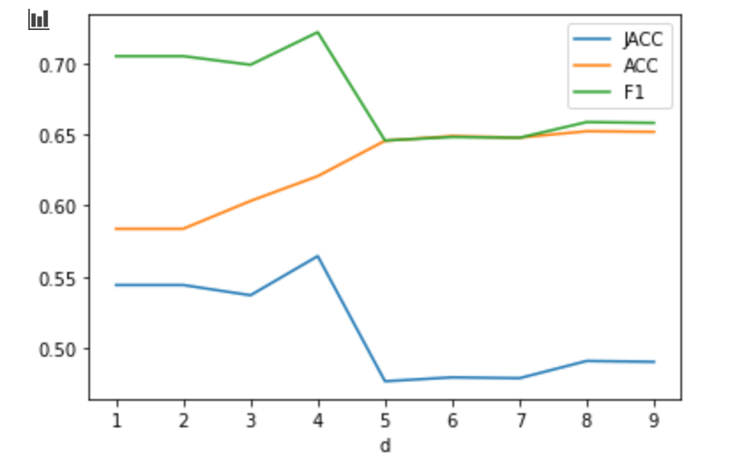
The best model trained here is by decision tree with depth of 4 with accuracy around 0.61 and F1 score around 0.71.

